Slide 1
Capital Reserve Committee
Deck Special Assessment
August 10, 2026

Slide 2

Decks – Timing & Funding
Timeline
Funding
2027 FY special assessment
Existing Reserves
* Require owner vote & approval
Deck rebuild determination – 6/30/26
Design concepts complete – 7/6/26
Full design complete – 7/21/26
Pricing received – 7/31/26
Price negotiation complete-8/8/26
Owner meeting & vote- 8/10/26
Work restarts – 8/17/26 est.
Work complete – 10/26/26 est.

Slide 3
Decks
Status
Delayed – 10 weeks
Decks over grass
Decks over asphalt
Concrete piers & wooden support posts will be added, matching the end decks.
Wooden corner posts for railing will be used on both the upper & lower deck to maintain aesthetics.
Steel tension rods will be used to hold up the decks. They will attach to the vertical wall structure & the deck structure.
Wall structure will be “beefed up”
Metal corner posts for the railing is required so that there is room to make the attachments of the rod.

Slide 4
Decks over grass– Decision Factors
Status
Delayed – 10 weeks
Why Post & Pier System was chosen over Tension Rod System
10,000 sf of previously installed NEW siding removed & replaced
Tension Rod system is more costly per deck
Tension Rod manufacture has an approx. 2-4 wk. lead time, leading to overall delay
Unknown conditions inside the walls, could lead to significant costs over 88 decks vs 16
Contractor is well versed in Post & Pier systems and will be able to progress quickly

Slide 5
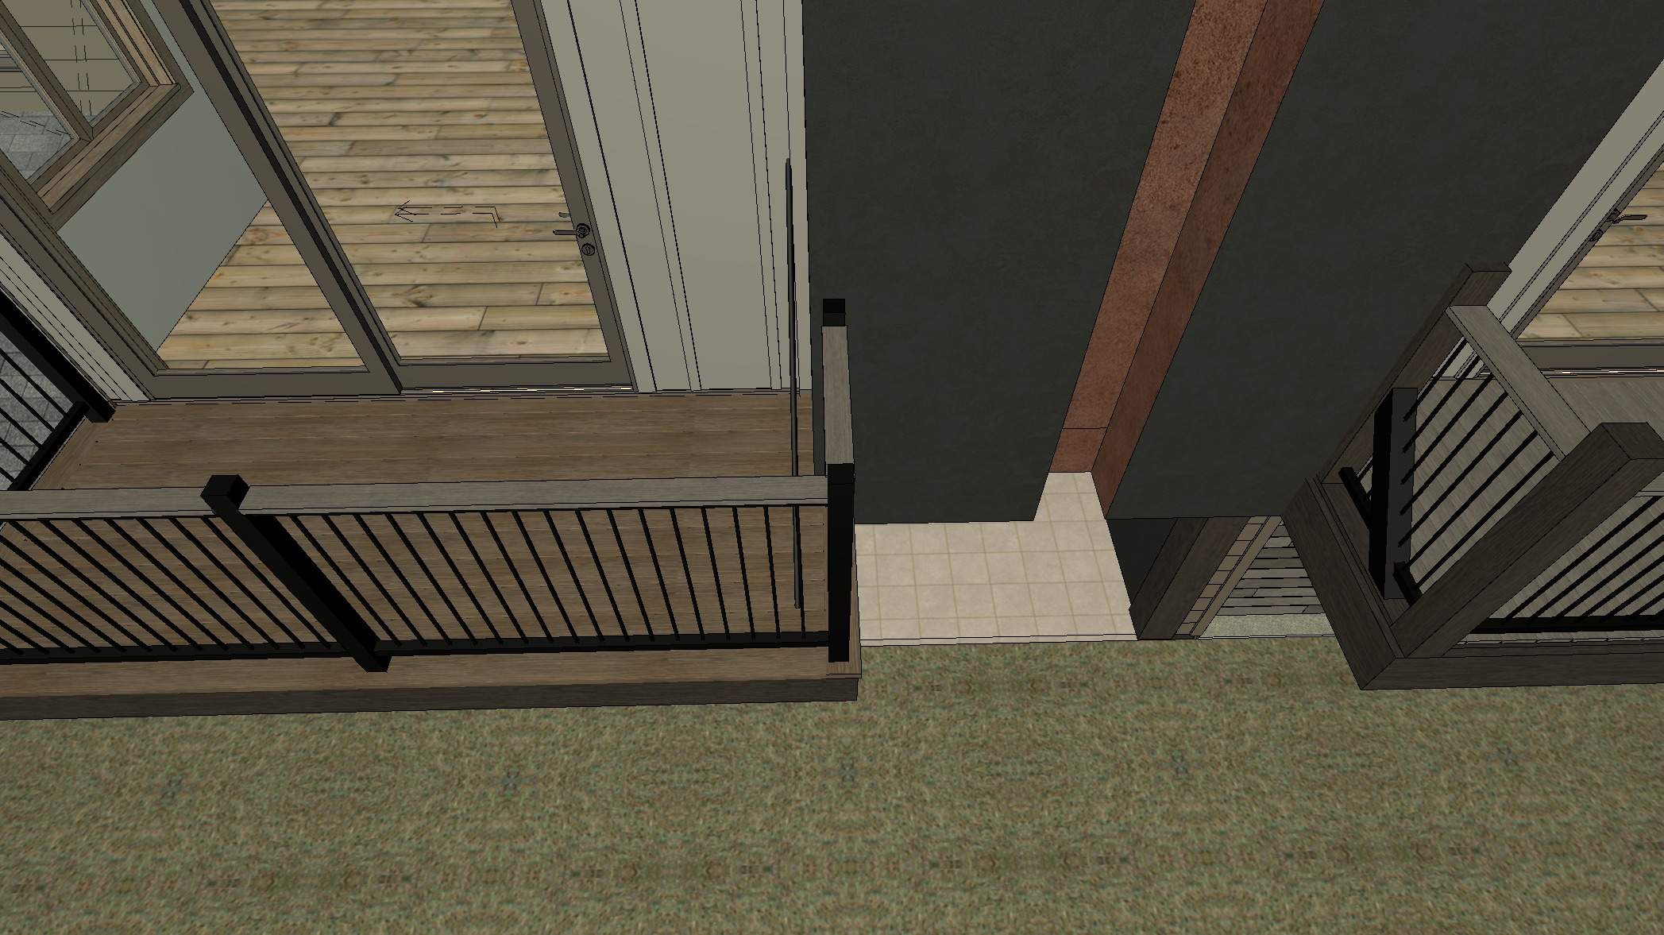
Decks: New Design – Steel Rod
[On Track / Delayed]
Steel support rods
5” drink rail
Metal railing posts

Slide 6
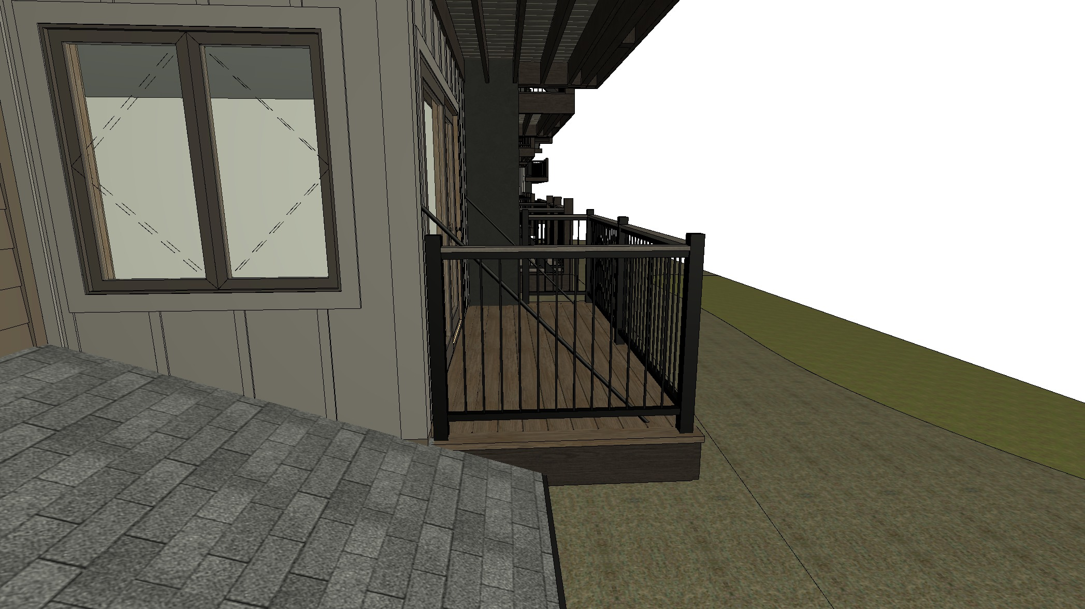
Decks – Steel Rod
[On Track / Delayed]

Slide 7
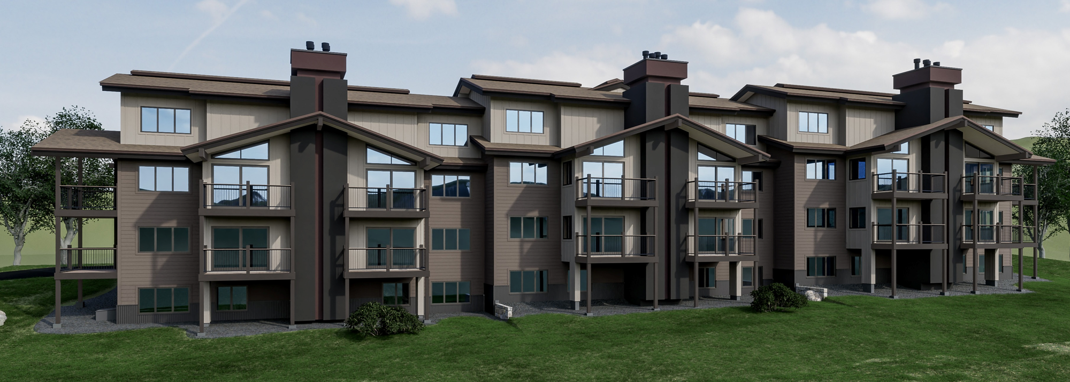
Decks: New Design – Piers & Posts
[On Track / Delayed]

Slide 8
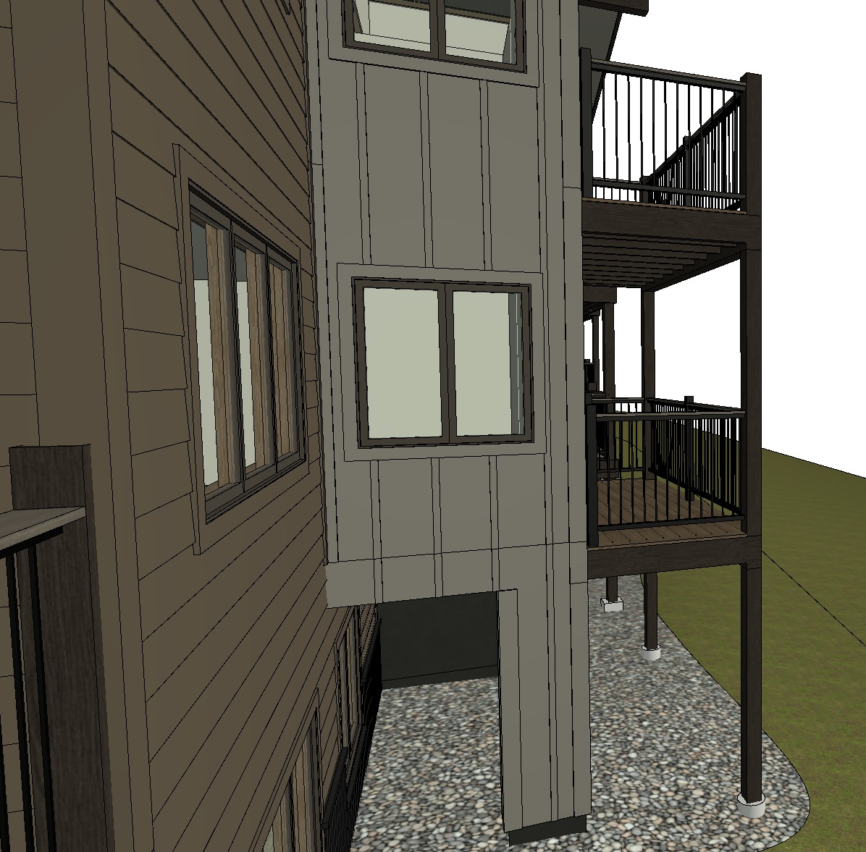
Decks: New Design – Piers & Posts
[On Track / Delayed]

